Slide 1
Azure Solution Alignment Workshop
Module 5a – Compute IaaS

Slide 2
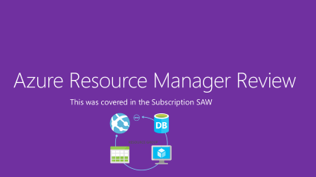

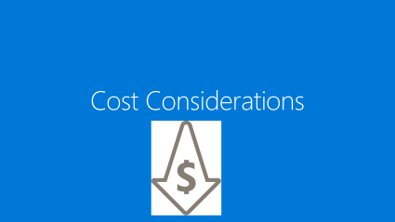
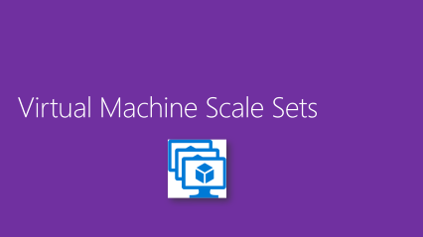
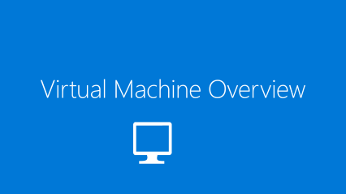
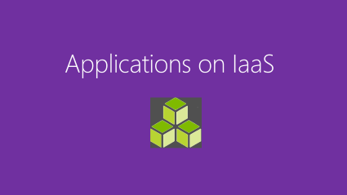
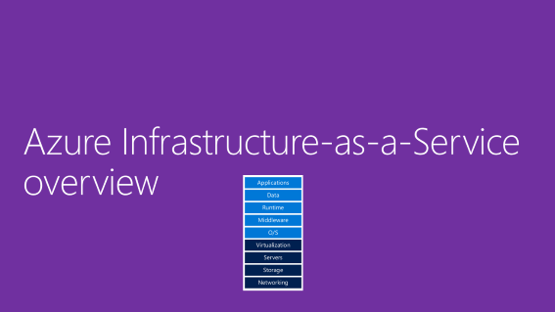
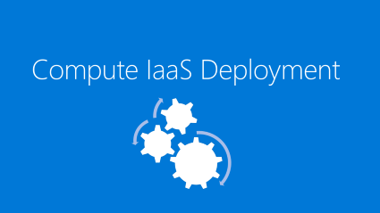
IaaS Compute Menu | Click a box

Slide 3
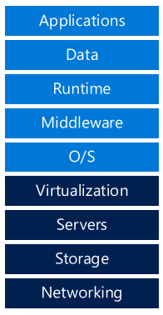
Azure Infrastructure-as-a-Service overview

Slide 4
Microsoft Azure compute (IaaS)
The focus of this section is on Microsoft’s IaaS capabilities, which in large part consist of storage, networking, backup and recovery, large scale computing and traditional Virtual Machine deployments
On-premises
Infrastructure
(as a Service)
Platform
(as a Service)
You manage
Applications
Applications
Applications
Managed by Microsoft
Data
Data
Data
Runtime
Runtime
Runtime
Middleware
Middleware
Middleware
O/S
O/S
O/S
Virtualization
Virtualization
Virtualization
Servers
Servers
Servers
Storage
Storage
Storage
Networking
Networking
Networking
Notes:
Many organizations require a transition to adopt a fully outsourced model
Lines of division between IaaS and PaaS responsibilities are blurred in applications which use both constructs
While PaaS is typically the goal, IaaS is a current reality most workloads both require and understand for some functions

Slide 5
IaaS Considerations
Size and number of Virtual Machines
Azure Virtual Machine storage requirements
Azure Virtual Network and VPN services
Network traffic out of Azure
Cost
Decide on name resolution: Azure-based or own DNS solution
Virtual Network overlay for enhanced security and isolation
Extension of the on-premises network to the cloud
Number of persistent private IP addresses required
Network
AutoScaling for increased or decreased load is different than PaaS
VMs are not load balanced by default
VM density per VNet (currently 4096)
Concurrent TCP connections for VMs roles (500K)
Limits

Slide 6
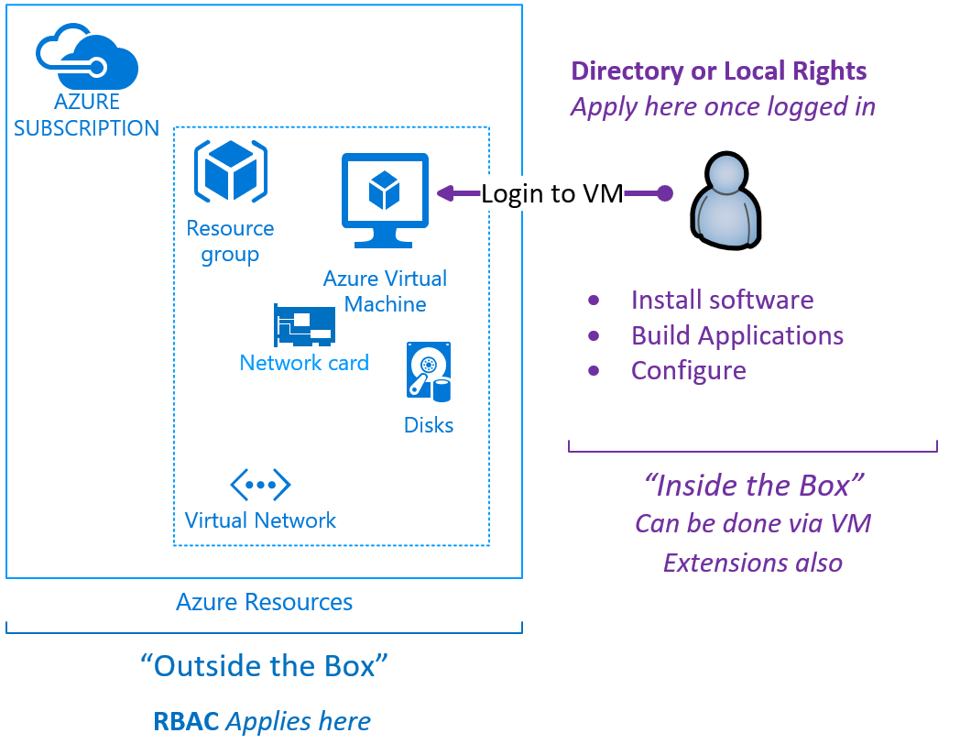
Inside or Outside the Box
Outside the Box
Think about the things you see in the portal
The blades, attributes, diagnostics, alerts etc.
RBAC Matters here
Inside the Box
Once you create a VM in Azure
Then you login to it
rights determined by directory or local
NOW you are inside the box
Anything you configure, install are processes you own
Same as you would do in Virtual or Physical Machines
VM Extensions preferred approach w/scripting

Slide 7
Virtual Machine Overview

Slide 8
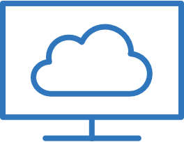



Virtual Machines
At a high level, Azure Virtual Machines (VMs) provide traditional virtualized server infrastructure to deploy a given application or service.
Portal
Virtual Machine
Virtual Machine
Azure Virtual Machine
REST API
Storage Blob
VHD
VHD
Gallery
User

Slide 9
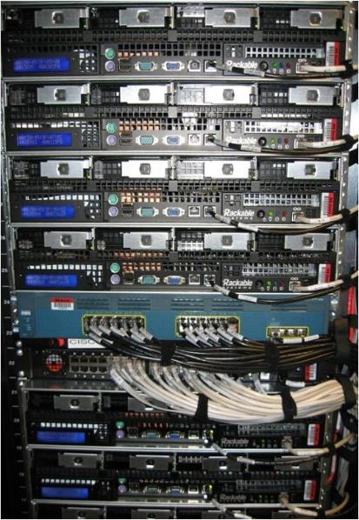
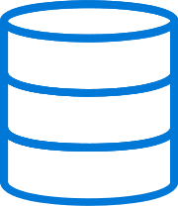
Availability sets
Virtual Machine
Virtual Machine
SQL Server primary
SQL Server secondary
High availability
Storage blob
Physical machines
Power unit
rack switch

Slide 10
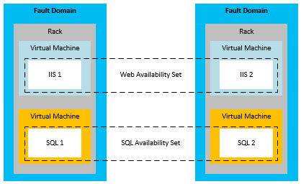
Availability Sets
…ensure that all instances of each tier have hardware redundancy by distributing them across fault domains, and are not taken down during an update.

Slide 11
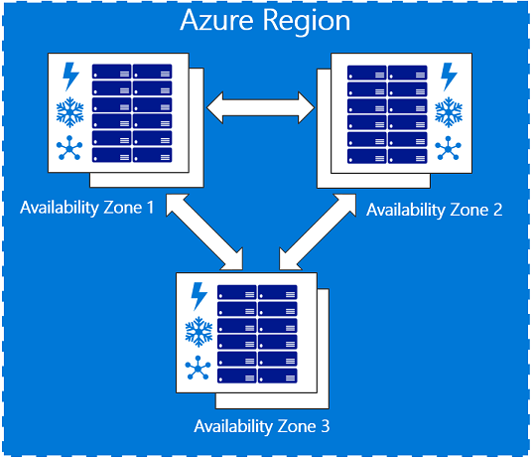
Availability Zones
Preview
Industry-leading SLA 99.99% for VM uptime
Fault-isolated locations within an Azure region
Creates redundant power, cooling and networking
Three separate Availability Zones per Azure Region
Increase HA and fault tolerance to datacenter failures
Physical and logical separation of AZ protect against DC failures
Current supported regions: East US 2, West Europe
aka.ms/Azure/AZ
Notes:
11/28/17
Regions that support Availability Zones
East US 2
West Europe
Services that support Availability Zones
The Azure services that support Availability Zones are:+
Linux Virtual Machines
Windows Virtual Machines
Zonal Virtual Machine Scale Sets
Managed Disks
Load Balancer
Supported virtual machine size families
Av2
Dv2
DSv2
Get started with the Availability Zones preview
The Availability Zones preview is available in the East US 2 and West Europe regions for specific Azure services. +
Sign up for the Availability Zones preview.
Sign in to your Azure subscription.
Choose a region that supports Availability Zones.
Use one of the following links to start using Availability Zones with your service.
Create a virtual machine
Create a zonal virtual machine scale set
Add a Managed Disk using PowerShell
Load balancer

Slide 12
The Spectrum of Protection Spanning the hardware to DataCenter to Regions
Protection radius
Data Residency boundary
Availability Sets
High Availability protection from hardware failures in a datacenter.
Availability Zones
High Availability protection against hardware, network, cooling, and power failures within a region.
Region Pairs
Protection for your data and applications from the loss of an entire region with GRS backup and Azure Site Recovery.
Hardware
Datacenter
Region
aka.ms/Azure/AZ
Notes:
11/28/17
Regions that support Availability Zones
East US 2
West Europe
Services that support Availability Zones
The Azure services that support Availability Zones are:+
Linux Virtual Machines
Windows Virtual Machines
Zonal Virtual Machine Scale Sets
Managed Disks
Load Balancer
Supported virtual machine size families
Av2
Dv2
DSv2
Get started with the Availability Zones preview
The Availability Zones preview is available in the East US 2 and West Europe regions for specific Azure services. +
Sign up for the Availability Zones preview.
Sign in to your Azure subscription.
Choose a region that supports Availability Zones.
Use one of the following links to start using Availability Zones with your service.
Create a virtual machine
Create a zonal virtual machine scale set
Add a Managed Disk using PowerShell
Load balancer

Slide 13
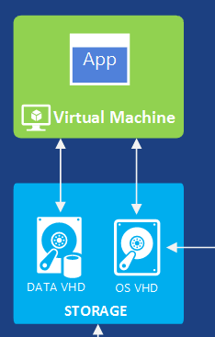
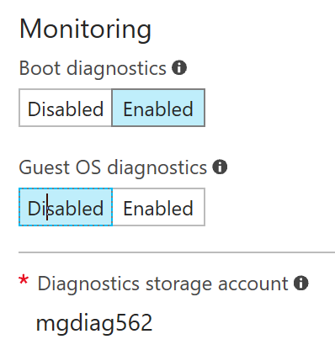
Virtual Machine Disks
VHD Format
OS | Persistent
SSD (Premium) | HDD
Temp Drive | temporary
Stored by default as Managed Disks, optionally Storage Accounts
Data Disks
# Data Disks determined by size
Diagnostics
Boot and/or Guest OS
Store in storage account
Notes:
IaaS solutions store images and disks used by VMs within VHDs, which attach to the computer instance as persistent or temporary storage. VMs can have a storage account or Managed Disk. Currently Azure support only supports the fixed VHD Format.

Slide 14
Virtual Machines – Extension models
Use available extensions for the following scenarios:
Connectivity and basic management
Deployment and configuration management
Security and protection
VM operations and management

Slide 15

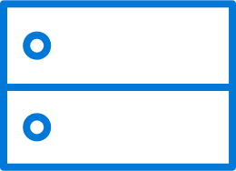




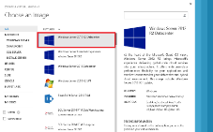
VM extensions
Extending the power of your VM
Enable easier management
Support partner ecosystem
Full control remains with you!
IaaS extended
Curated extensions
Agent
Azure

Slide 16

Virtual Machine Scale Sets
Notes:
NOTE: This is a lot more behind the covers on this section. If you want to learn it well, please review AZR336: VM Scale Sets – Deep dive https://techreadytv.com/TR23/session?sCode=AZR336
Also, many resources are stored on http://aka.ms/Azure/VMSS
You should be familiar with overvprovision on this topic if you want to be a little deep. It is discussed on the TR session above. It is not included here to keep it simple!

Slide 17
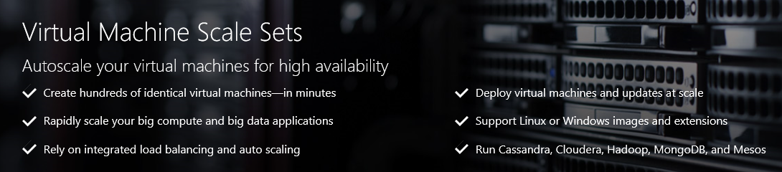
Virtual Machine Scale Sets
Deploy and manage VMs as a set
An Azure Compute resource Microsoft.Compute/virtualMachineScaleSets
Integrated with Azure Autoscale
Integrated with Azure Load Balancer
A scalable, platform-independent infrastructure for PaaS
aka.ms/Azure/VMSS

Slide 18
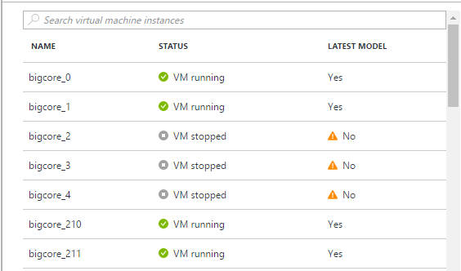
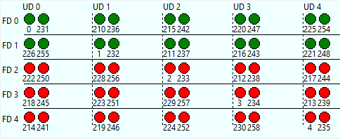
Why VM Scale Sets?
Modern cloud applications need:
Scale - Deploy identical resources
Easily
Rapidly
At scale.. 10s – 10,000s of cores
Customization – PaaS-like ease of use with custom infrastructure requirements
Availability - Roll out updates without service interruption
Low cost - Dynamically increase/decrease compute power to optimize costs
Elasticity - Automatically scale to changing demand

Slide 19
Autoscale
Simultaneously:
Scale on a specific day
Scale on a recurring schedule
Scale on resource metrics
Auto-email your ops team! ;)
Integrate with external APIs via Event Hooks
Comes with basic payload
Add your own payload
Debug with Audit Logs and Azure Storage Explorer

Slide 20
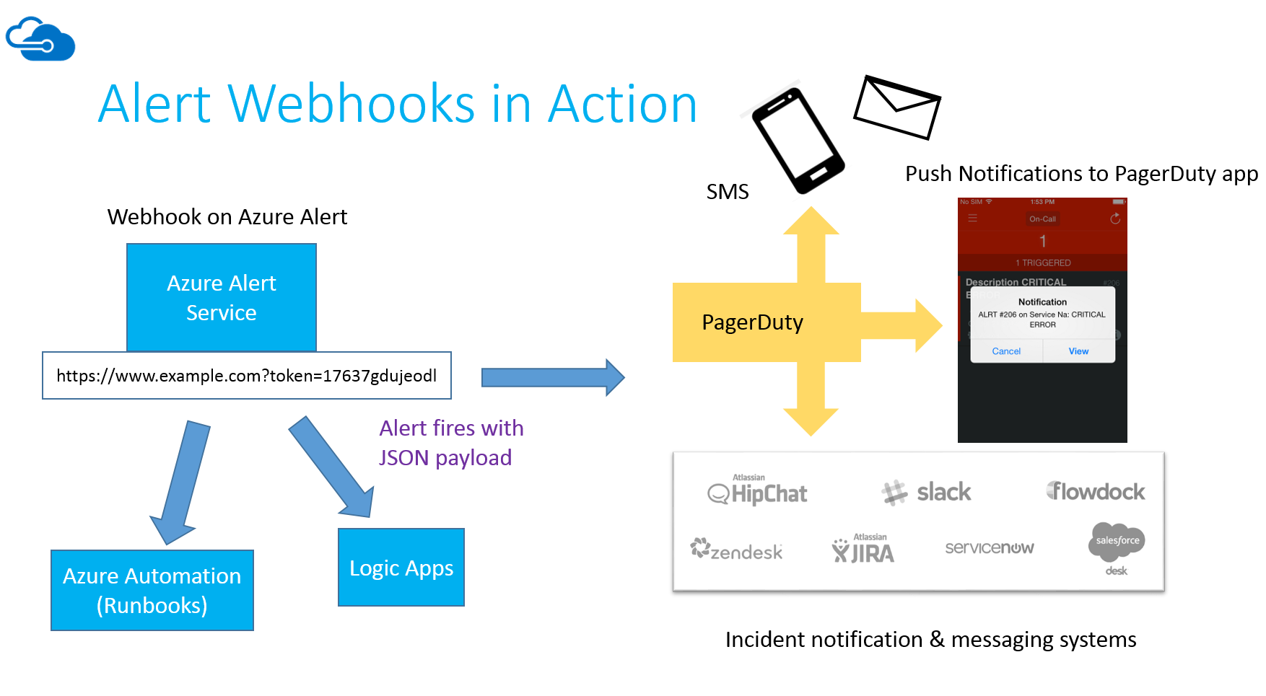
Alerts & Autoscale notifications with PagerDuty

Slide 21
Cost Considerations
Notes:
NOTE: This is a lot more behind the covers on this section. If you want to learn it well, please review AZR336: VM Scale Sets – Deep dive https://techreadytv.com/TR23/session?sCode=AZR336
Also, many resources are stored on http://aka.ms/Azure/VMSS
You should be familiar with overvprovision on this topic if you want to be a little deep. It is discussed on the TR session above. It is not included here to keep it simple!

Slide 22
Cost considerations
Budgeting consumption vs. traditional IT investment
The shift to consumption budget planning is challenging
Current IT spend does not consider this model
Azure IaaS migration is not always 1:1
Current model is to “over-purchase” for on-premises solutions
Simplistic review of the existing infrastructure does not accurately reflect the expected Azure footprint ← “right-size”
Consumption budgeting requires a shift in thinking
Shift thinking towards understanding utilization and scaling
Focus on initial deployment followed by incremental growth
Take advantage of the elasticity of Azure services as part of transition
Watch Cost Savings with Azure Virtual Machines @MS Ignite 2017

Slide 23
Cost
One of the primary considerations when constructing solutions
Cost factors
The high-level cost model and measurement (e.g. cost per hour for Virtual Machines)
Cost drivers
The unit-level costs and design decisions which impact costs (e.g. the number of active Virtual Machines required, or the type of storage utilized)

Slide 24
General Purpose
Compute Optimized
Memory Optimized
Storage Optimized
GPU
High Performance Compute
Virtual Machine Types
B, Dsv3, Dv3, DSv2, Dv2, DS, D, Av2, A0-7
Fsv2, Fs, F
Esv3, Ev3, M, GS, G, DSv2, DS, Dv2, D
Ls
NV, NC, NCv2, ND
H, A8-11
aka.ms/Azure/Sizes
Notes:
When deploying applications and solutions using Microsoft Azure Virtual Machines, there are various sizing configurations that are available to organizations. From a sizing perspective, each sizing series represents various properties such as:
Number of CPUs
Memory allocated to each Virtual Machine
Temporary local storage
Allocated bandwidth for the Virtual Machine
Maximum data disks

Slide 25
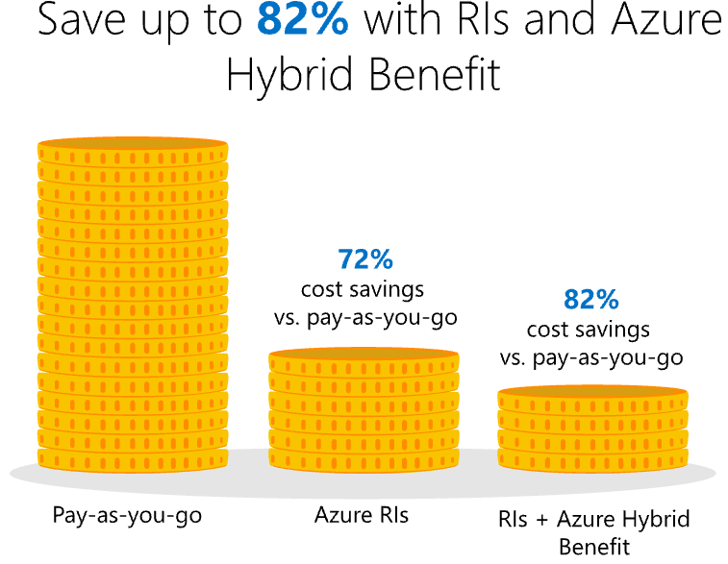
Azure Reserved Virtual Machine Instances | Overview
Virtual Machine Reservation
Select VM size, region, term (one or three years), and quantity. There is no need to select OS.
Integration with A Hybrid Benefit
You can use Azure Hybrid Benefit for Windows Server or pay hourly based on usage.
Flexible across OS choice
Reservations are for the “base VM” and can be applied to either Windows Server and/or non-Windows Server VMs.
aka.ms/Azure/RI GA effective Nov 16, 2017
Notes:
Term based discounts
Up to 72% discount versus pay-as-you-go
1 or 3 year terms, windows or Linux
Combine with Azure Hybrid Benefit, save up to 82%
Not all Azure resources have a prebuilt roles
Custom roles allow customers to fill in the gaps
Copy an existing role and edit the allowed actions (or NotActions)
Create from scratch
Must define where the role can be assigned
Must apply the custom role to each subscription so it can be used

Slide 26
Azure Reserved Virtual Machine Instances | Benefits
Predictable price
Prioritized compute capacity
Ease of purchase
Assignment control
Post-purchase flexibility
1- and 3-year term options
Global datacenters
Select region, VM size, and term
Scope reservation either to enrollment or subscription
Exchange or cancel reservations

Slide 27
IaaS network considerations
There are two models for network configurations for Azure VMs: Cloud-only and cloud-premises VNet configurations.
Cloud-only
This implementation does not leverage VNet gateways to connect back to the on-premises network or to other Azure VNets. Connection to VMs is obtained through the public endpoints, rather than through a VPN connection.
Cross-premises
This implementation offers grater flexibility as multi-site, VNet-to-VNet, and ExpressRoute configurations offer the needed flexibility to extend the on-premises network to the cloud and extend to multiple networks in Azure. Most cross-premises connectivity involve a VPN device for a secure connection with the VNet, however, a direct connection using ExpressRoute can be obtained to Azure and bypass the internet altogether. Covered more in the Networking Workshop

Slide 28
Azure Resource Manager Review
This was covered in the Subscription SAW
RESOURCE GROUP
Notes:
NOTE: this is included for a refresh or if the majority of this audience was NOT in the Subscription Workshop. If they are good with the content, return to the menu and go to the Deployment section.

Slide 29
Resource groups (resource management (ARM))
Manage resources as a single unit Role-based access control (RBAC) on groups or resources
Billing integrated tagging on groups or resources
Container for multiple resources
IaaS + PaaS resources
Resources exist in one* resource group
Resource groups can span regions
Resource groups can span services
RESOURCE GROUP

Slide 30
Single vs. multiple resource groups
Single resource group
Storage account
Front-end VMs
Virtual Network
Back-end VMs
Multiple resource groups
RG1:
Storage account
RG3: Front-end VMs
RG2: Virtual Network
RG4: Back-end VMs

Slide 31
Resource tags
Name-value pairs assigned to resources or groups
Subscription-wide taxonomy
Each resource can have up to 15 tags
Tagging Tips
Notes: Simple note for VM
Creator: Track the “owner” of a VM
Department/cost center: Who pays
Environment: Production vs. pre-production vs. test

Slide 32
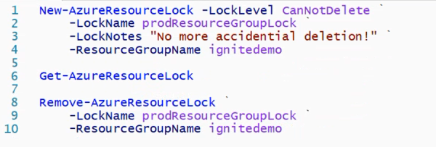
Resource locks
Resource locks prevent accidental deletion
Allow admins to create policies against deletion
Policy enforces a lock level (CanNotDelete)

Slide 33
Resource groups – Role-based access control

Slide 34
RBAC – Two key concepts
Role assignments
Associate role definitions with an identity (e.g. user/group) at a scope (e.g. resource group)
Always inherited – Subscription assignments apply to all resources
Role definitions
Describes the set of permissions (e.g. read actions)
Can be used in multiple assignments

Slide 35
RBAC – Built-in versus custom definitions
Azure has prebuilt RBAC resource roles
Defined for specific resources
Defined for groups of resources
Not all Azure resources have a prebuilt roles
Custom roles allow customers to fill in the gaps
Copy an existing role and edit the allowed actions (or NotActions)
Create from scratch
Must define where the role can be assigned
Must apply the custom role to each subscription so it can be used

Slide 36
RBAC role definitions
Determine what a role definition can do
(get-azurermroledefinition "<role name>").actions
(get-azurermroledefinition "<role name>").notactions

Slide 37
Compute IaaS Deployment

Slide 38
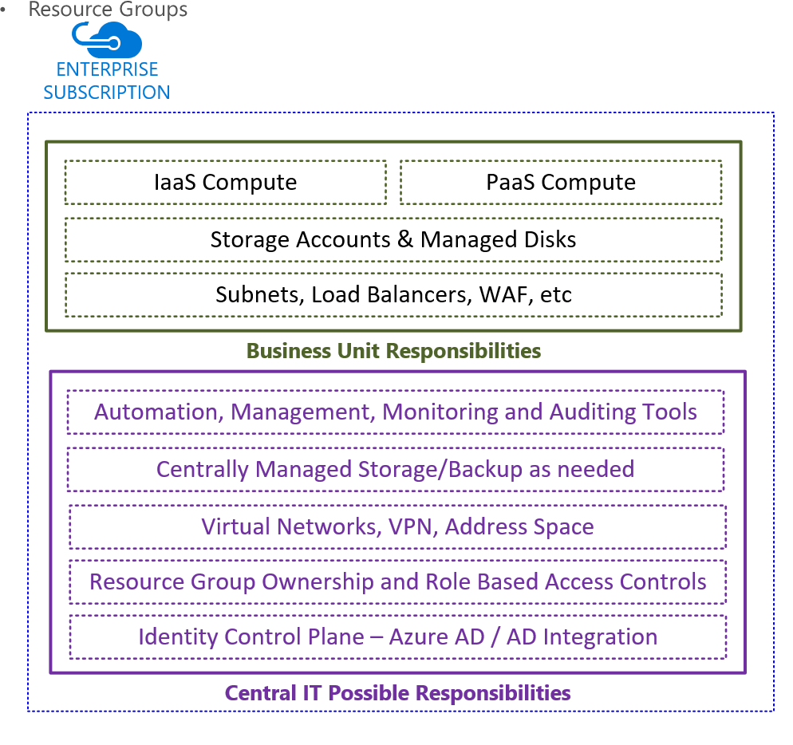
Who’s owns what parts - examples
Central IT / Contractor
Azure Active Directory
Subscription Owner rights
Resource Groups
Storage Accounts
Virtual Networks - owner
Biz Unit or Organization
IaaS Compute
Contributor Rights only
Availability Sets
Load Balancers
WAF, etc
These are internal discussions for Separation of Duties if needed and applies
Notes:
Often times there is a central IT group, or else an enterprise’s subscription is managed by a third party contractor. This is a higher level conversation, but will need to be addressed to determine who will do what. More specifically, what department or organization will be deploying the solution. In this case the Azure IaaS Compute. NOTE: this is NOT an exact answer, but one idea. Don’t spend a lot of time on this slide, but add it to post workshop discussions. The company you are working with should have an offline conversation about this, if they already have not. And then you should come back together to talk about the pros and cons of separation of duties.

Slide 39
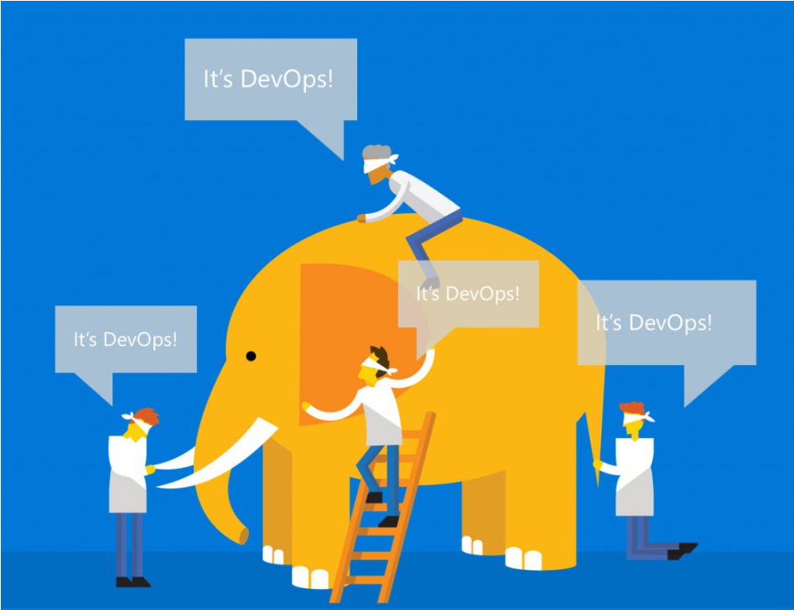
Deployment Methods
Quickstarts
Marketplace
Azure Quickstarts
ARM Templates
Visual Studio
Methods
Portal – Cloud Shell
Azure PowerShell
Azure CLI
Continuous
Automation
CI/CD pipelines
DevOps aka.ms/Azure/DevOps
We’ll cover more later
Notes:
Cloud Shell
PowerShell or Azure CLI 2.0 / BASH
Authenticate and run from
Portal.azure.com
Shell.azure.com
Mobile App! aka.ms/Azure/Mobile

Slide 40
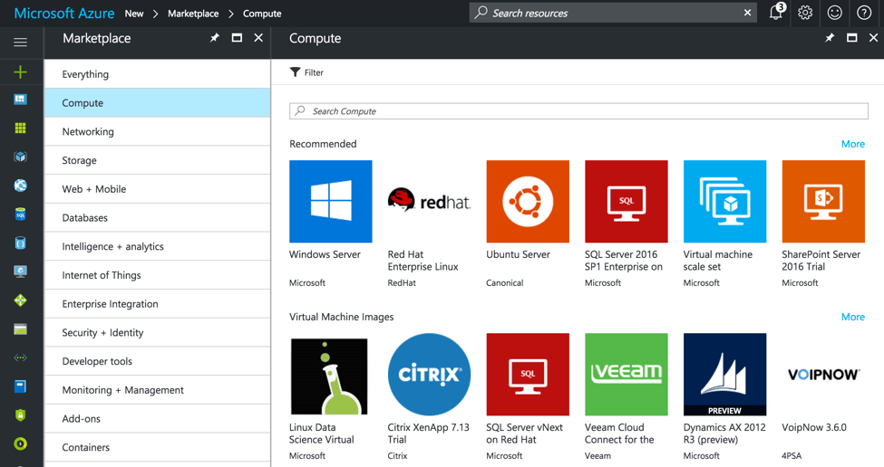
Virtual Machine Marketplace images
The Marketplace offers a library of images, both Microsoft and partner provided, which can be used to create IaaS Virtual Machines.

Slide 41
Virtual Machine – Marketplace and image models
Images make it easier to deploy an application into the Azure environment. The following are the four models of Azure Images:
Image families
VHDs managed and supported by Microsoft. Some may include pre-installed software and configuration.
Partner images
VHDs uploaded by partners for application consumption by the Azure customer. VMs deployed using partner images are not deployed on the same cluster or clusters as other VM workloads.
Latest images
Images are kept as versions in Azure. Typically, you would want to choose the latest image.
Customized images
Customer uploaded VHDs to leverage their own images. This is due to internal security, standard costs, and licensing scenarios.

Slide 42
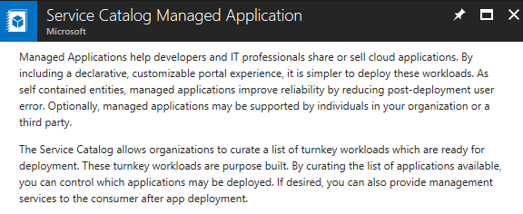
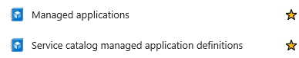
Azure Managed Applications
Introduction
Offer Cloud solutions to consume
Publish in Marketplace or
Publish Internal Catalog for private use
Service Catalog
Internally approved solutions
Employees search those IT approved
aka.ms/Azure/ManagedApplications
Notes:
Managed applications reduce barriers to consumers using your solutions. They do not need expertise in cloud infrastructure to use your solution. Consumers have limited access to the critical resources. They do not need to worry about making a mistake when managing it.
Managed applications enable you to establish an ongoing relationship with your consumers. You define terms for managing the application, and all charges are handled through Azure billing.
Although customers deploy these managed applications in their subscriptions, they don't have to maintain, update, or service them. You can ensure that all customers are using approved versions. Customers don't have to develop application-specific domain knowledge to manage these applications. Customers automatically acquire application updates without the need to worry about troubleshooting and diagnosing issues with the applications.
For IT teams, managed applications enable you to offer pre-approved solutions to users in the organization. You ensure these solutions are compliant with organizational standards.

Slide 43
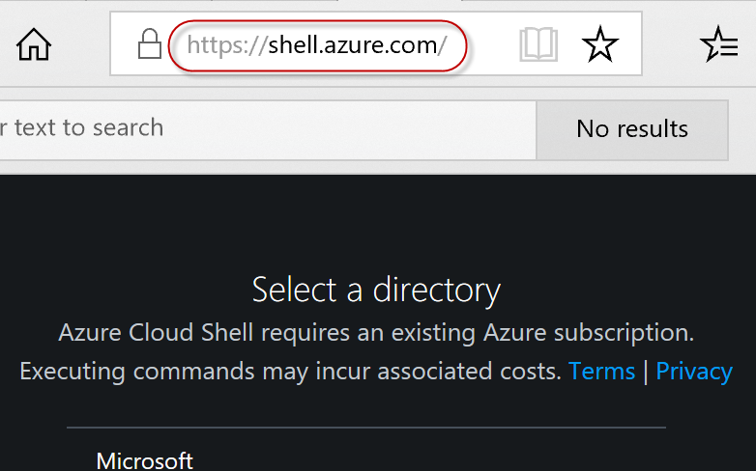
Deployment options
Manual
Not easily repeatable
Not easy to copy the deployment to a second region or subscription
Client-driven automation
Solves a lot of the manual deployment issues
Burden of deployment logic and dependencies in the script execution and order
Uses imperative logic
Hard to parallelize
Cloud Shell
PowerShell or Azure CLI 2.0 / BASH
Authenticate and run from
Portal.azure.com
Shell.azure.com
Mobile App! aka.ms/Azure/Mobile

Slide 44
Deployment options – ARM templates
Cloud-based orchestration engine
Fully declarative
Automatically optimizes the deployment based on dependency graph
Complements and integrates PowerShell automation for deployment tasks

Slide 45
Power of repeatability
Azure templates can:
Ensure idempotency
Simplify orchestration
Simplify roll-back
Provide cross-resource configuration and update support
Azure templates are:
Source file, checked-in
Specifies resources and dependencies (VMs, Web Apps, DBs) and connections (config, LB sets)
Parametrized input/output
Instantiation of repeatable config.
Configuration → Resource group
SQL-A
Web App
[SQL CONFIG] VM (2x)
DEPENDS ON SQL
DEPENDS ON SQL
SQL - A
Web App
Virtual
Machines
SQL
C
ONFIG

Slide 46


Azure Resource Manager
Building a Virtual Machine
Resource group
virtualMachine
hardwareProfile
osProfile
storageProfile
networkProfile
Subnet
VM
networkInterface
privateIPAllocationMethod
storageAccount
accountType
NIC
Public IP
Storage
publicIPAddress
allocationMethod
domainNameLabel
virtualNetwork
addressSpace
Subnet
addressPrefix
VNet
https://github.com/Azure/azure-quickstart-templates/tree/master/101-vm-simple-windows

Slide 47
Resource loops
Declare multiple resources
Resource group
Subnet
Subnet
VM
VM
VM
…
NIC
NIC
NIC
VNet
Storage
Storage
Public IP
Public IP
Public IP
https://docs.microsoft.com/en-us/azure/azure-resource-manager/resource-group-create-multiple

Slide 48
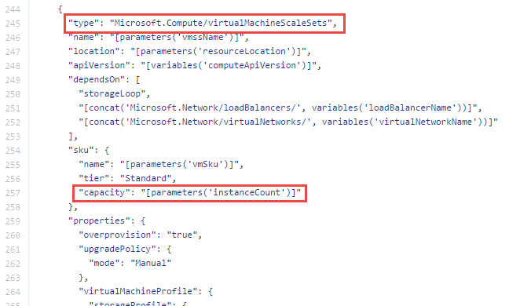
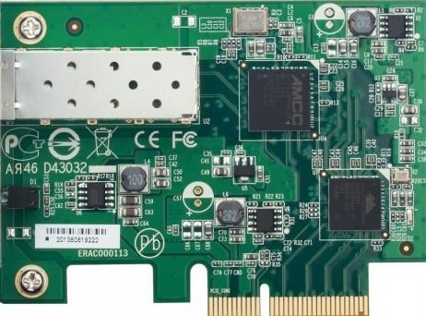
VM Scale Sets in Azure Resource Manager
Resource Group
Scale Set
Subnet
VM
VM
VM
VM
…
Scalable NIC
Scalable Storage
Extensions
VNET
https://github.com/Azure/azure-quickstart-templates - *vmss*

Slide 49
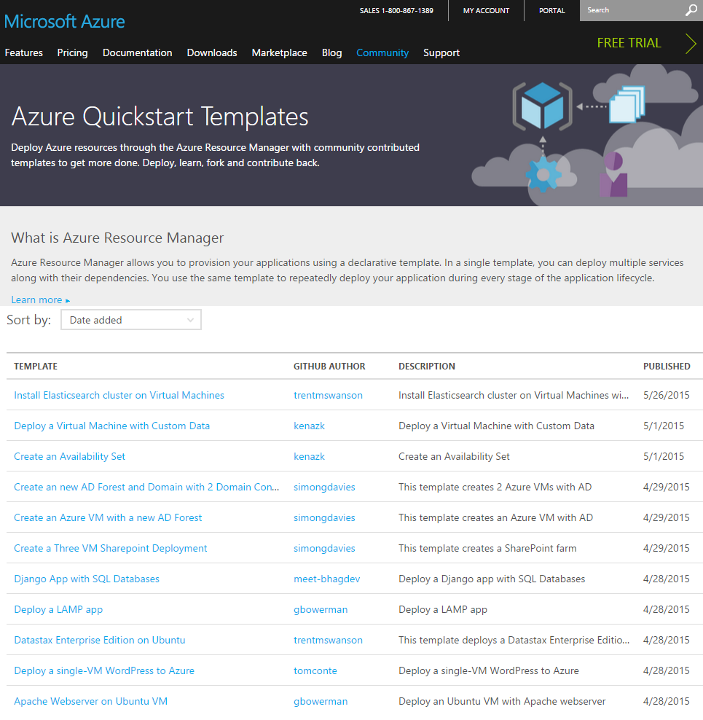
Getting started with Azure templates
Wide range of Quickstart templates
Indexed on Azure.com
Github Repo - https://github.com/Azure/azure-quickstart-templates
Community and Microsoft contributed
Integration of IaaS with Azure Services
Azure Resource Explorer
https://resources.azure.com/

Slide 50
Template execution
Execution engine builds a state machine
dependsOn and reference() establish dependencies
App Insights
After Website Completes
After App Service Plan Completes
Once All Complete
Web
Site
Alert Rule
Start
App Service Plan
End
Auto Scale Setting
MS Deploy PKG

Slide 51
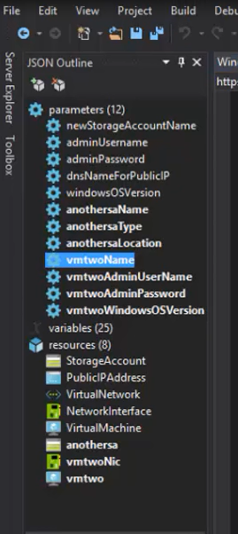
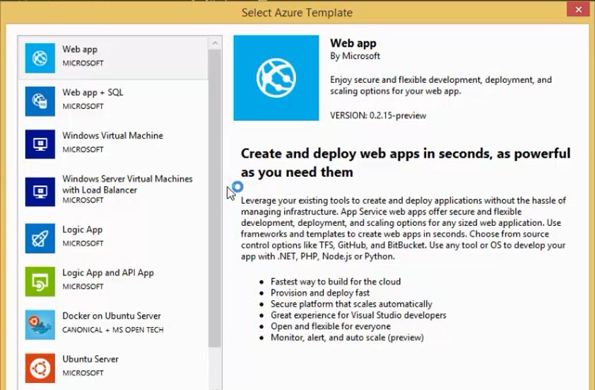
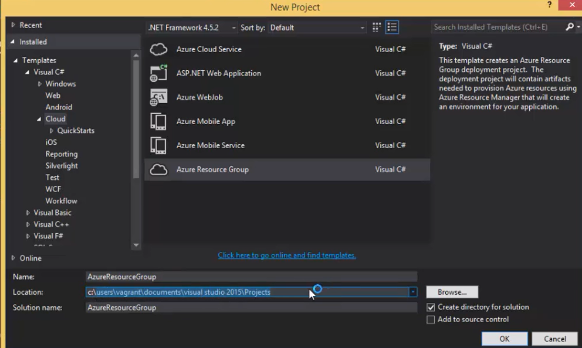
Deployment with Visual Studio

Slide 52
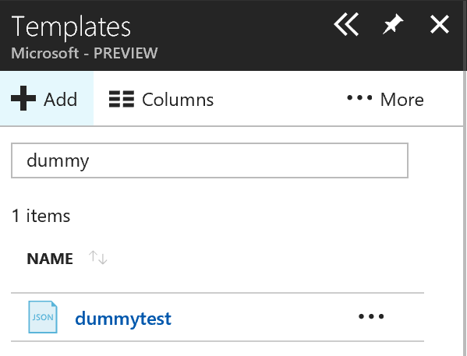
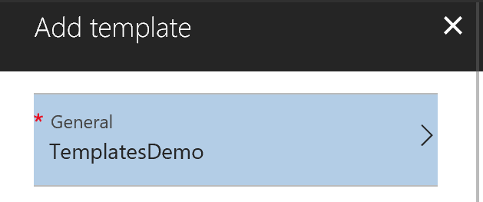
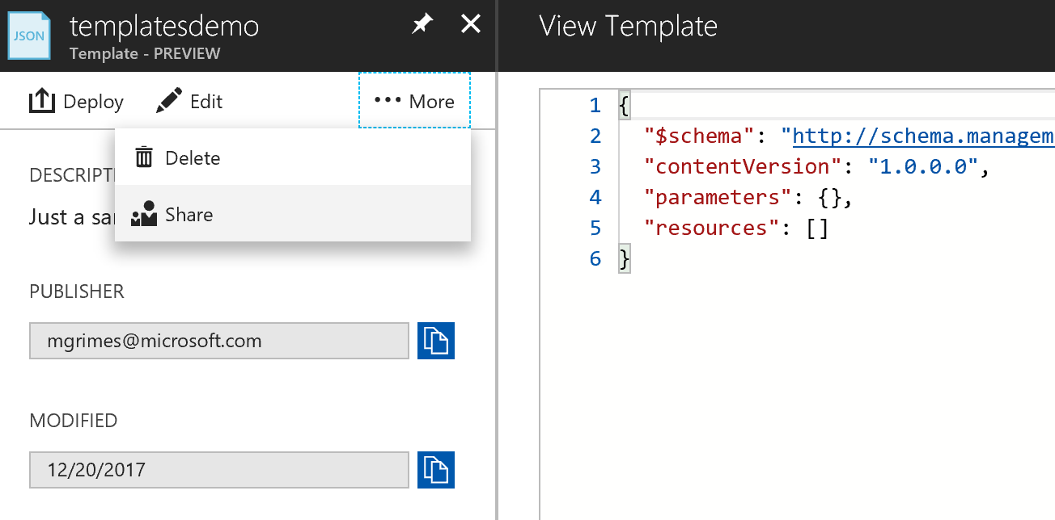
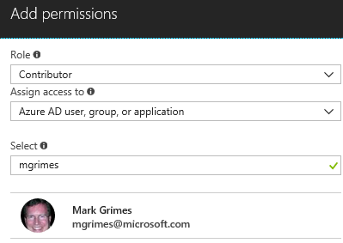
Templates - preview
Portal Storage
Create and Store in the Blade
Share with others in your organization
RBAC only lets those see with access
Edit directly
Copy and paste QuickStarts here
aka.ms/Azure/Templates

Slide 53

Applications on IaaS

Slide 54

Simplified manageability of applications on IaaS
Upgrade
Complexity made simple
Master template can be used to rollout upgrades
Imperative APIs, client tools support to update resources
Manageability, auditing
Operations can be tracked up to 90 days (activity logs)
Management locks to lock down resources from deletion

Slide 55
Architecting complex applications on IaaS
Infrastructure
Templates for different environments (eg: Dev, Test, Prod)
Orchestration of multiple infrastructure tiers (eg: VMs, VNets)
Orchestration across multiple Azure resources (eg: VMs, Websites)
In-VM configuration
Common scripts/recipes that can be shared across multiple VMs
App-specific scripts that will be used for application setup

Slide 56
Example Architecture: Web App with AZs
Traffic Manager
VNet
Web front end across 3 AZs
VIP/Load balancer per AZ
Traffic Load balanced across VIPs using Traffic Manager
Data layer redundant across 3 AZs
SQL on IaaS
SQL Azure or CosmosDb
NoSQL (Cassandra, MongoDb)
Availability Zone 1
Availability Zone 2
Availability Zone 3
Web App
Web App
Web App
Front End Subnet
SQL
SQL
SQL
DB Subnet

Slide 57
Example Architecture: SQL Server AlwaysOn
Zone redundant Load Balancer
VNet
Stateless front end deployed across 2 AZs
SQL AlwaysOn with witness in AZ3
Zone redundant Load balancer
Availability Zone 1
Availability Zone 2
Availability Zone 3
Web App
Web App
Front End Subnet
SQL
SQL
Witness
DB Subnet

Slide 58
Design Review Checklist
Application Design
Avoid any single point of failure
Deploy multiple instances of services
Use Availability sets per application tier
Use Load Balancing to distribute
Use multiple instances of Application Gateways
Deploy application across multiple regions
Use Traffic Manager to route different regions
Security
Implement Least Privilege
WAFs, NSGs, multiple VMs behind load balancer with public IP
See Design Review Checklist

Slide 60
Key decisions

Slide 61
Virtual Machine – Sizes and tiers decisions
Choosing between Basic and Standard Tier VMs
Considerations | Decision points
CPU | Decide on Standard tier VMs when expected to have slightly better CPU performance than basic tier VMs.
Disk | Data disk IOPS for basic tier VMs is 300 IOPS, which is slightly lower than standard tier VM which has 500 IOPS data disk. Decide whether IOPS greater than 300 is needed. For higher IOPS, standard Tier DS VMs start at 3200.
Features | Decide whether the workloads will need support for load balancing or auto-scaling. Basic tier VMs do not support features such as load balancing or auto-scaling.
Availability | Standard Tier VMs are available on all sizes instances.

Slide 62
Virtual Machine – Sizes and tiers decisions
Considerations | Decision points
A-Series | Decide on using A8, A9, A10, and A11 as its hardware is designed and optimized for compute and network intensive applications including HPC cluster applications, modeling and simulations. Choose A8 and A9 instances to leverage the ability to communicate over low latency, high throughput networks in Azure using RDMA technology for MPI applications. Choose A10 and A11 instances for HPC applications that do not require constant and low latency communication between nodes. These do not include the RDMA network in Azure.
D(v2/v3)/Ev3-Series | Choose D(v2/v3)-series VMs as they are designed to run higher compute power and temporary disk performance applications through their faster processors, higher memory to core ratio, and SSDs for their temporary disk. Ev3 sizes provide more memory to vCPU than the Dv3 to run larger workloads on sizes up to the largest E64 size, with 64 vCPUs and 432GiB of RAM.
F(S)-Series | Choose F-series VM for optimized for compute-intensive workloads. This series contains 10 additional compute-optimized VM sizes and the option to optimize for standard or premium storage.
DS-Series | Choose DS-Series VMs when using Premium Storage. Consider that the maximum IOPS and throughput (bandwidth) possible with a DS series VM is affected by the size of the disk.
G-Series | Decide on this Tier of VMs to leverage local SSD disks for higher performance.
GS-Series | Choose GS-Series VMs when using Premium Storage for the highest performance VM series across Azure.
H-Series | Choose H-Series VMs for Compute and Network Intensive applications (similar to A8-A11, see here for more information.
N-Series | Choose N-Series VMs for Visualization/Compute-related scenarios targeting GPU support.

Slide 63
Virtual Machine – Capability decisions
Capability considerations
Considerations | Decision points
Supportability | Decide on the application to run in an Azure VM as 32-bit applications are not supported.

Slide 64
Virtual Machine – Storage decisions
Considerations when planning storage accounts for VMs on non-Managed Storage
Considerations | Decision points
Virtual Machines considerations | Choose to maintain the storage account and VM in the same region. Choose to use storage account of Managed Disk for VM. Disable geo-replication on the storage account when the workload provides availability or if multiple disks are spanned together. Avoid using OS or temporary disks for database storage or logging. Avoid using data disk caching options where not supported by the workload or solution running in the VM. Choose to stripe multiple data disks to get increased IO throughput. Format with documented allocation sizes. Move all data related files to data disks, including system databases. Backup directly to blob storage when possible
Scalability and storage throttling | For VMs in the Basic Tier, do not place more than 66 highly used VHDs in a storage account to avoid 20,000 total requests rate limit (20,000/300). For VMs in the Standard Tier, do not place more than 40 highly used VHDs in a storage account (20,000/500).

Slide 65
Virtual Machine – Placement decisions
Consider the following aspects when choosing resource groups:
Considerations | Decision points
Application Lifecycle Container | Choose when deploying and management of application is done for the same resources.
Declarative Solution for Deployment and Configuration | Choose when finding the need of multiple instantiations of your application.
Consistent management layer | Choose when consistent results are expected for the application or service vs. inconsistency that might be caused using the portal or other CLI Azure Tools.

Slide 66
Virtual Machines – Extension decisions
Decide on the following for VM extensions based on considerations
Considerations | Decision points
Connectivity and Basic Management | VMAccessAgent (Windows) VMAccessForLinux (Linux)
Deployment and Configuration Management | Custom VM Script Chef Puppet PowerShell DSC MS Enterprise Application
Security and protection | CloudLinkSecureVMWindowsAgent AzureDiskEncryption McAfeeEndpointSecuirty TrendMicroDSA PortalProtectExtension IaaSAntimalware SymantecEndpointProtection
VM operations and management | IaaS Diagnostics OSPatchingForLinux

Slide 67
IaaS considerations – Cost decisions
Considerations | Decision points
Size and number of VMs | Consider licensing costs and understand what is included in the VM Image.
Azure storage requirements | Understand VM storage costs are billed separate from the VM Compute aspect.
Azure Virtual Network | Charges are applied for the creation of VPN connections between a VNet and your VPN gateway. The charge is per available and provisioned hour. Data transferred over the VPN is charged separately at the Azure standard transfer rates.
Network traffic | Consider that OB data is charged based on the total amount of data moving out of the Azure datacenters through the Internet. As an example, outbound directory synchronization serves as a common case
Support | Flexible options for all organizations sizes are available. Consider additional support for business critical applications.

Slide 68
IaaS considerations – Networking decisions
Considerations | Decision Points
Name resolution | Decide between Azure provided DNS and bringing your own DNS solution.
Security and isolation | Consider using VNets to provide an added layer of isolation, as only VMs that are part of the same VNet can access each other.
Extended connectivity boundary | Consider creating VNets and placing VMs within a single VNet in order to have them communicate with each other directly without requiring VNet peering or S2S VPN connectivity.
Extend your on-premises network to the cloud | Consider joining Azure VMs to your on-premises domain in order to access and leverage on-premises monitoring and identity services.
Persistent private IP addresses | Configure a static IP address to ensure your VM retains its private IP address even when Stop/Deallocated.

Slide 69
IaaS considerations – Limitations decisions
Considerations | Decision points
Auto-scaling | Consider utilizing monitoring and automation capabilities such as the Azure monitoring agent and Azure automation to dynamically scale and deploy application code to VM instances in the environment.
Load balancing | Consider creating and applying a load balancer to VMs.
Multiple NICs | Consider the following limitations before using multi-NIC VMs: NICs in Azure VMs cannot forward traffic or act as Layer 3 (IP) gateways. The order of the NICs inside the VM will be random, but the IP addresses and the corresponding MACs will remain the same.
Density | Consider creating a new VNet and extend the network by connecting the VNets altogether to avoid the VNet VM limit of 2048.
Concurrent TCP connections | Consider the limit of TCP connections for a VM: 500K.

Slide 70
IaaS considerations – Management decisions
Considerations | Decision Points
IIS logs | Consider gathering information about IIS websites.
Azure diagnostic infrastructure logs | Consider gathering information about diagnostics itself.
IIS failed request logs | Consider gathering information about failed requests to an IIS site or application.
Windows event logs | Consider gathering information sent to the Windows Event Logging System.
Performance counters | Consider gathering OS and custom performance counters.
Crash dumps | Consider gathering information about the state of the process in the event of an application crash.
Custom error logs | Consider gathering logs created by your application or service.
.NET EventSource | Consider gathering events generated by your code using .NET EventSource class.
Manifest-based ETW | Consider gathering ETW events generated by any process.

